Slide 1

A PROJECT PRESENTATION ON “Real-Time Face Detection
and Recognition”
GROUP NO: 15 Members names 1)NAVNATH AUTI 2)BINITDEV PANDEY 3)SAHIL NAZARE 4)ADNAN SHAIKH UNDER THE GUIDANCE OF Prof. HEMALATA GOSAVI
Department of Computer Engineering Saraswati College of Engineering, Kharghar, Navi Mumbai University of Mumbai 2022-23

Slide 2

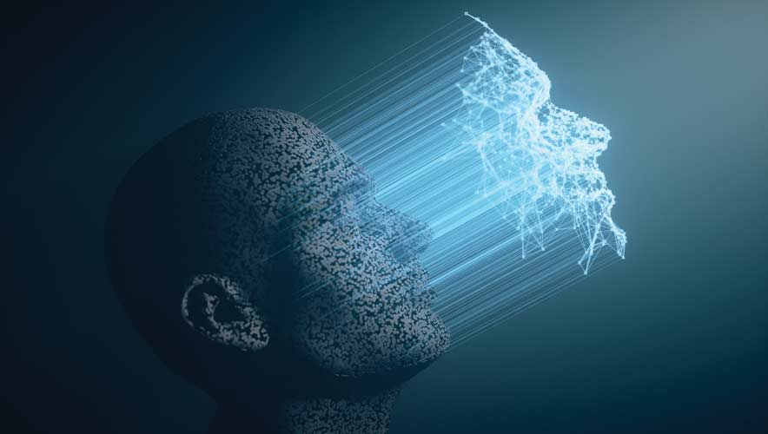
Real-Time
Face Detection and Recognition
Real-Time Face Recognition integrated with CCTV

Slide 3
TABLE OF CONTENTS
Introduction
Backend
Frontend
Techniques and Tools (Models and System Specification)
Conclusion

Slide 4
INTRODUCTION
Real-time face detection and recognition required expensive computation and current system uses cloud backend for face recognition and charge monthly fees and other personal computer recognition app cannot be used in real-time.
Real-time face detection and recognition brings real-time face recognition app for pc by leveraging the power of multiple cores and machine learning.

Slide 5
BACKEND
PyQT5 linking with IP camera and face detection video streaming thread
One-to-one analysis of face recognizers with their average time on lfw_faces
Integrated analysis of face detectors and face recognizers using multiprocessing
Trained SVM classifier for face classification
Average distance measures classification (L2 norm and Cosine distance)
One-to-many, accuracy and time-efficiency analysis of face detectors, recognizers and classifiers on tmoc video (in-progress)
Frame dropping heuristic to reduce bottleneck in multiprocessing queue

Slide 6
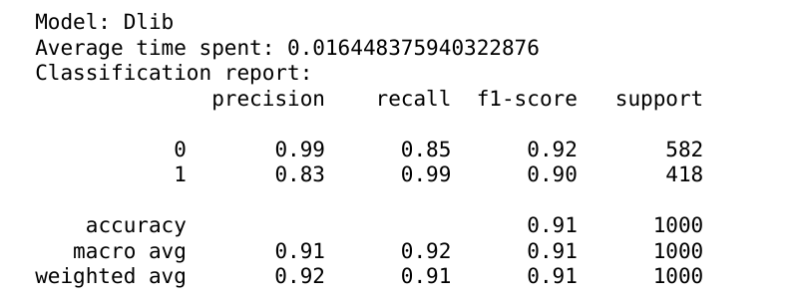
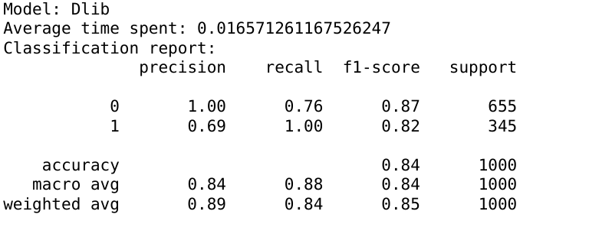
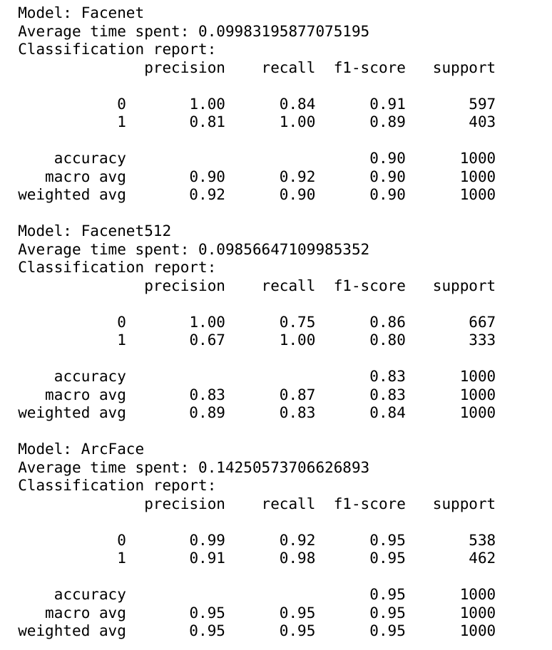
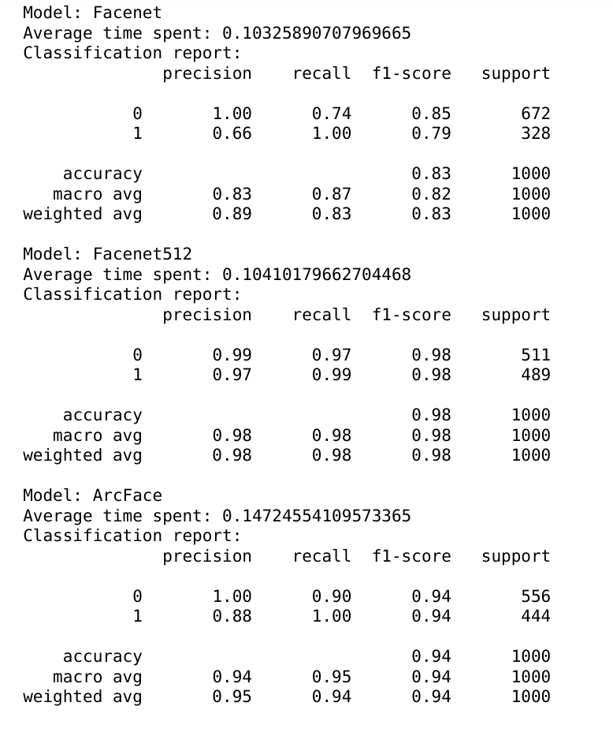
ONE-TO-ONE ANALYSIS RESULT
cosine distance
L2 norm
cosine distance
L2 norm

Slide 7
ONE-TO-ONE ANALYSIS RESULT
cosine distance
L2 norm
cosine distance
L2 norm

Slide 8
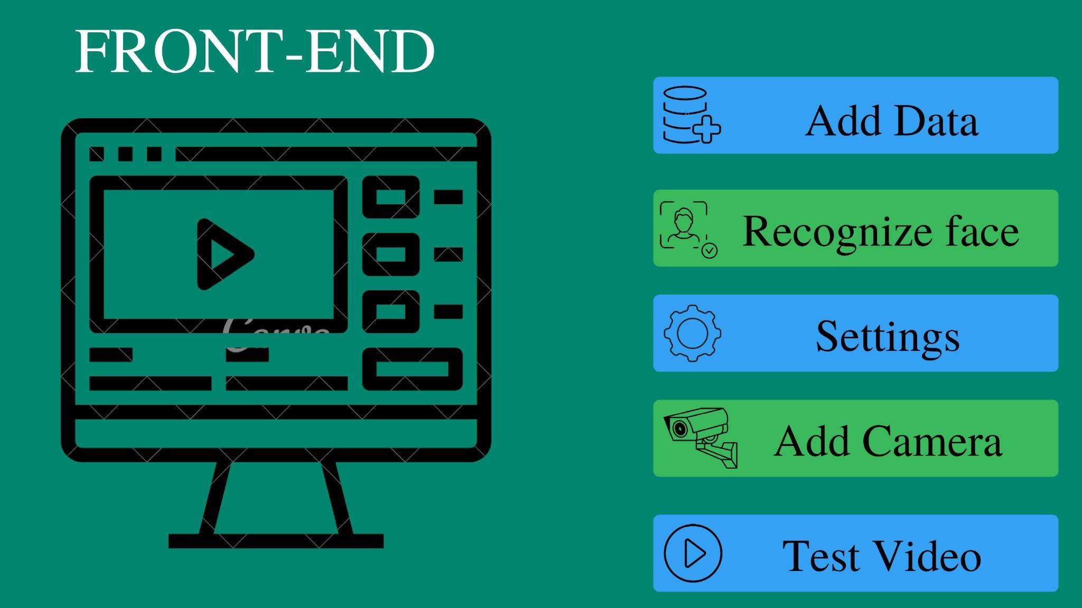

Slide 9
TECHNIQUES AND TOOLS
ALGORITHM
Detectors: MTCNN and MediaPipe (Blazeface)
Recognizer: Facenet, Facenet512, ArcFace and Dlib
Classifier: SVM
Optimization
Parallel processing of recognizer and detector
Parallel processing queue for data passing
Frame dropping heuristic

Slide 10
TECHNIQUES AND TOOLS CONTINUE
Language
Python 3.7 and above
Libraries and Framework:
PyQt5
Tensorflow
Numpy
Deepface
Pandas
Scikit-learn
Joblib
Multiprocessing

Slide 11
TECHNIQUES AND TOOLS CONTINUE
Hardware
Tp Link IP camera tapo-200
i7-10 gen, i5-12 gen and i5-10 gen cpu
8 gb to 16 ram
Other software
Visual studio code
Jupyter-notebook
PyQt5 designer (compatible with python <=3.9)

Slide 12

CONCLUSION
Real-time face detection and recognition on single core is time inefficient process while other cores sits idle. We leverage the power of multiple cores, use of multiprocessing queue to pass frames between process and applied heuristic for frames dropping to prevent bottleneck of frames queue.

Slide 13
REFERENCE
[1] Edwin Jose, Greeshma M, Mithun Haridas T. P, “Face Recognition based Surveillance System Using FaceNet and MTCNN on Jetson TX2” 2019 5th International Conference on Advanced Computing & Communication Systems (ICACCS).
[2] Rehmat Ullah , Hassan Hayat, Afsah Abid Siddiqui, Jebran Khan, Farman Ullah, “A Real-Time Framework for Human Face Detection and Recognition in CCTV Images” 2022 Hindawi Mathematical Problems in Engineering.
[3] Paul Viola, Michael J. Jones, “Robust Real-Time Face Detection” July 11, 2003 International Journal of Computer Vision.
[4] Kaipeng Zhang, Zhanpeng Zhang, Zhifeng Li, Senior Member, IEEE, and Yu Qiao, Senior Member, IEEE, “Joint Face Detection and Alignment Using Multitask Cascaded Convolutional Networks” October 10, 2016 IEEE SIGNAL PROCESSING LETTERS, VOL. 23
[5] F. Schroff, D. Kalenichenko and J. Philbin, "FaceNet: A unified embedding for face recognition and clustering," 2015 IEEE Conference on Computer Vision and Pattern Recognition (CVPR), Boston, MA, 2015, pp. 815-823. 2
[6] Y. Sun, X. Wang, and X. Tang. Deeply learned face representations are sparse, selective, and robust. CoRR, abs/1412.1265, 2014. 1, 2, 5, 8.

Slide 14
REFERENCE
[7] Y. Taigman, M. Yang, M. Ranzato, and L. Wolf. Deepface: Closing the gap to human-level performance in face verification. In IEEE Conf7. on CVPR, 2014. 1, 2, 5, 8.
[8] Valentin Bazarevsky, Yury Kartynnik Andrey, Vakunov Karthik Raveendran, Matthias Grundmann. BlazeFace: Sub-millisecond Neural Face Detection on Mobile GPUs
[9] Vidit Jain, Erik Learned-Miller. FDDB: A Benchmark for Face Detection in Unconstrained Settings
[10] Yu Shen, Kuan-Wei Chen, Yizhou Hao, Min Hsuan Wu. Face Detection with Deep Learning.
[11] Ning Zhang, Junmin Luo, Wuqi Gao. Research on Face Detection Technology Based on MTCNN .
[12] Zouhair Mbarki, Besma Miladi, Chiraz Jabeur Seddik, Maryem Fadhly and Hassene Seddik. Real Time Face Detection and Identification from Video Sequences Combining LBP Algorithm and Convolutional Neural Network.

Slide 15
Thank You!

